Slide 1
EPA Vehicle Recommendations
David Chi

Slide 2
Overview
Goal
To provide data backed feedback and analysis based on vehicle fuel economy based on criteria such as vehicle types, manufacturers, and technical specs.
Considerations
The main factors we considered in this study were based on vehicle fuel type in relationship with the savings over a 5 year period.
Methods
We used the independent samples T Test to test the means of cost savings from the EPA.
Data
38,000 records from years 1984 to 2017 covering 133 unique car makes.

Slide 3
Hypotheses
H0 – There is no difference in cost savings between electric vehicle and traditional fuel types such as regular gasoline, premium gasoline, and diesel.
Ha – There is a difference in cost savings between electric vehicle and traditional fuel type vehicles such as regular gasoline, premium gasoline, and diesel.

Slide 4
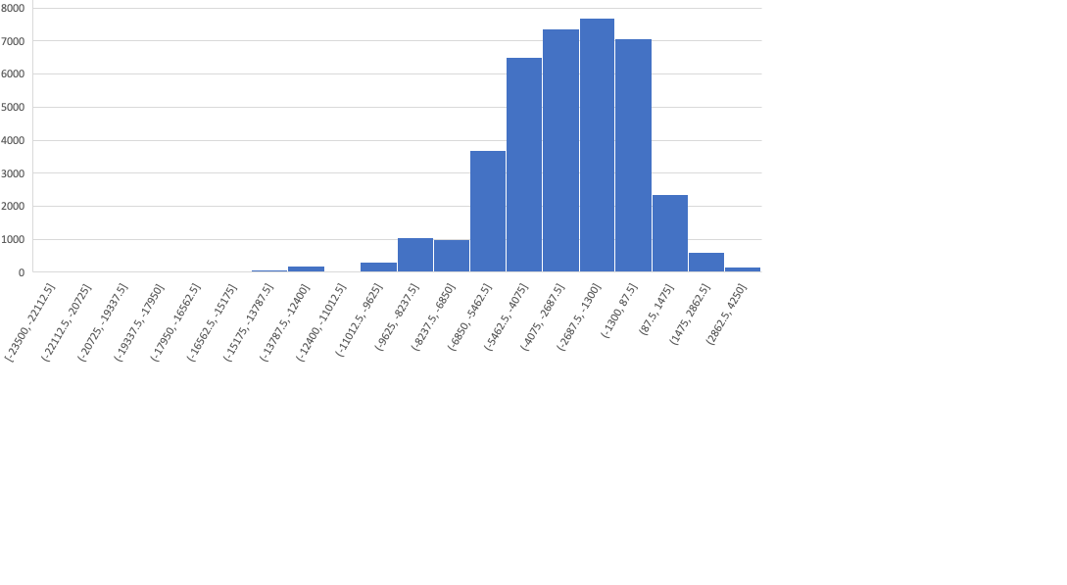
Descriptive Statistics
Distribution is normal.
Cost Savings Data
Mean | -3101.779
Standard Error | 13.6511297
Median | -3000
Mode | -5000
Standard Deviation | 2665.0138
Sample Variance | 7102298.53
Kurtosis | 1.75129145
Skewness | -0.7913583
Range | 27750
Minimum | -23500
Maximum | 4250
Sum | -118215000
Count | 38112

Slide 5
Electricity VS Regular Gas
t-Test: Two-Sample Assuming Unequal Variances
 | Electricity | Regular |  |  | Electricity | Regular
Mean | 2872.180451 | -2509.650408 |  | Mean | 2872.18045 | -2509.6504
Variance | 2307402.028 | 5825457.703 |  | Variance | 2307402.03 | 5825457.7
Observations | 133 | 25258 |  | Observations | 133 | 25258
Hypothesized Mean Difference | 0 |  |  | Standard Error | 131.715175 | 15.1867746
df | 136 |  |  | c.i. upper | 260.474765 | 30.0327698
t Stat | 40.59069334 |  |  | c.i. lower | 260.474765 | 30.0327698
P(T<=t) one-tail | 3.4886E-78
t Critical one-tail | 1.656134988
P(T<=t) two-tail | 6.9772E-78
t Critical two-tail | 1.977560777
Total Sample Size | 25391
Mean Difference | 5381.830859
Standard Error of Difference | 132.5878032
Confidence Interval | 262.200439
Lower Limit | 5119.63042
Upper Limit | 5644.031298
H0 – There is no difference in cost savings between electric vehicle and premium gasoline vehicles.
Ha – There is a difference in cost savings between electric vehicle and premium gasoline vehicles.
Reject the null that there is no difference in cost between electric and regular gasoline vehicles.
The difference is significant at the <.05 level. With 95% confidence, the difference is between 5119 and 5644 means.

Slide 6
Electricity VS Premium Gas
t-Test: Two-Sample Assuming Unequal Variances
 | Electricity | Premium |  |  | Electricity | Premium
Mean | 2872.18045 | -4684.2742 |  | Mean | 2872.18045 | -4684.2742
Variance | 2307402.03 | 6790389.52 |  | Variance | 2307402.03 | 6790389.52
Observations | 133 | 10133 |  | Observations | 133 | 10133
Hypothesized Mean Difference | 0 |  |  | Standard Error | 131.715175 | 25.8867973
df | 142 |  |  | c.i. upper | 260.376007 | 51.1733054
t Stat | 56.2927636 |  |  | c.i. lower | 260.376007 | 51.1733054
P(T<=t) one-tail | 2.691E-99
t Critical one-tail | 1.65565517
P(T<=t) two-tail | 5.382E-99
t Critical two-tail | 1.97681099
Total Sample Size | 10266
Mean Difference | 7556.4546
Standard Error of Difference | 134.23492
Confidence Interval | 265.357065
Lower Limit | 7291.09754
Upper Limit | 7821.81167
H0 – There is no difference in cost savings between electric vehicle and premium gasoline vehicles. Ha – There is a difference in cost savings between electric vehicle and premium gasoline vehicles.
Reject the null that there is no difference in cost between electric and premium gasoline vehicles.
The difference is significant at the <.05 level. With 95% confidence, the difference is between 7291 and 7822 means.

Slide 7
Electricity VS Diesel
t-Test: Two-Sample Assuming Unequal Variances
 | Electricity | Diesel |  |  | Electricity | Diesel
Mean | 2872.18045 | -2158.5306 |  | Mean | 2872.18045 | -2158.5306
Variance | 2307402.03 | 5416415.31 |  | Variance | 2307402.03 | 5416415.31
Observation | 133 | 1014 |  | Observations | 133 | 1014
Hypothesized Mean Difference | 0 |  |  | Standard Error | 131.715175 | 73.0864725
df | 223 |  |  | c.i. upper | 259.565691 | 144.028512
t Stat | 33.3969763 |  |  | c.i. lower | 259.565691 | 144.028512
P(T<=t) one-tail | 4.8825E-89
t Critical one-tail | 1.65171532
P(T<=t) two-tail | 9.7651E-89
t Critical two-tail | 1.97065896
Total Sample Size | 1147
Mean Difference | 5030.71102
Standard Error of Difference | 150.633728
Confidence Interval | 296.847705
Lower Limit | 4733.86332
Upper Limit | 5327.55873
H0 – There is no difference in cost savings between electric vehicle and diesel vehicles.
Ha – There is a difference in cost savings between electric vehicle and diesel vehicles.
Reject the null that there is no difference in cost between electric and diesel gasoline vehicles.
The difference is significant at the <.05 level. With 95% confidence, the difference is between 4734 and 5328 means.

Slide 8
Recommendations
Electric powered vehicles had some of the highest cost savings across across all vehicles and should be the first choice if a consumer is looking to save money.
The buyer should take into consideration other factors such as charging, range, and vehicle cost to determine which car will be the right choice.
Gas prices are at record high with national gas price for regular gas at $4.97 and $5.69 for diesel. The cost savings may become even greater in the future with an electric vehicle if prices stay high and vehicle prices come down.

